Slide 1
Designing for the Future of Finance
Dave Rochlin and Rupa Ruchismita
July 8th, 2024
@Chou Hall
Praveen,
Chief Product Officer,
PayZen

Slide 2
Designing for the vulnerable at population scale
Multi-party (Non profit, climate modelers, Government, Refinancing Bank, Insurers, Regulator)
Multi-year, Iterative design
A UNFCC recognised innovation!
South Asia’s first climate catastrophe insurance: Meso-level flood index insurance

Slide 3
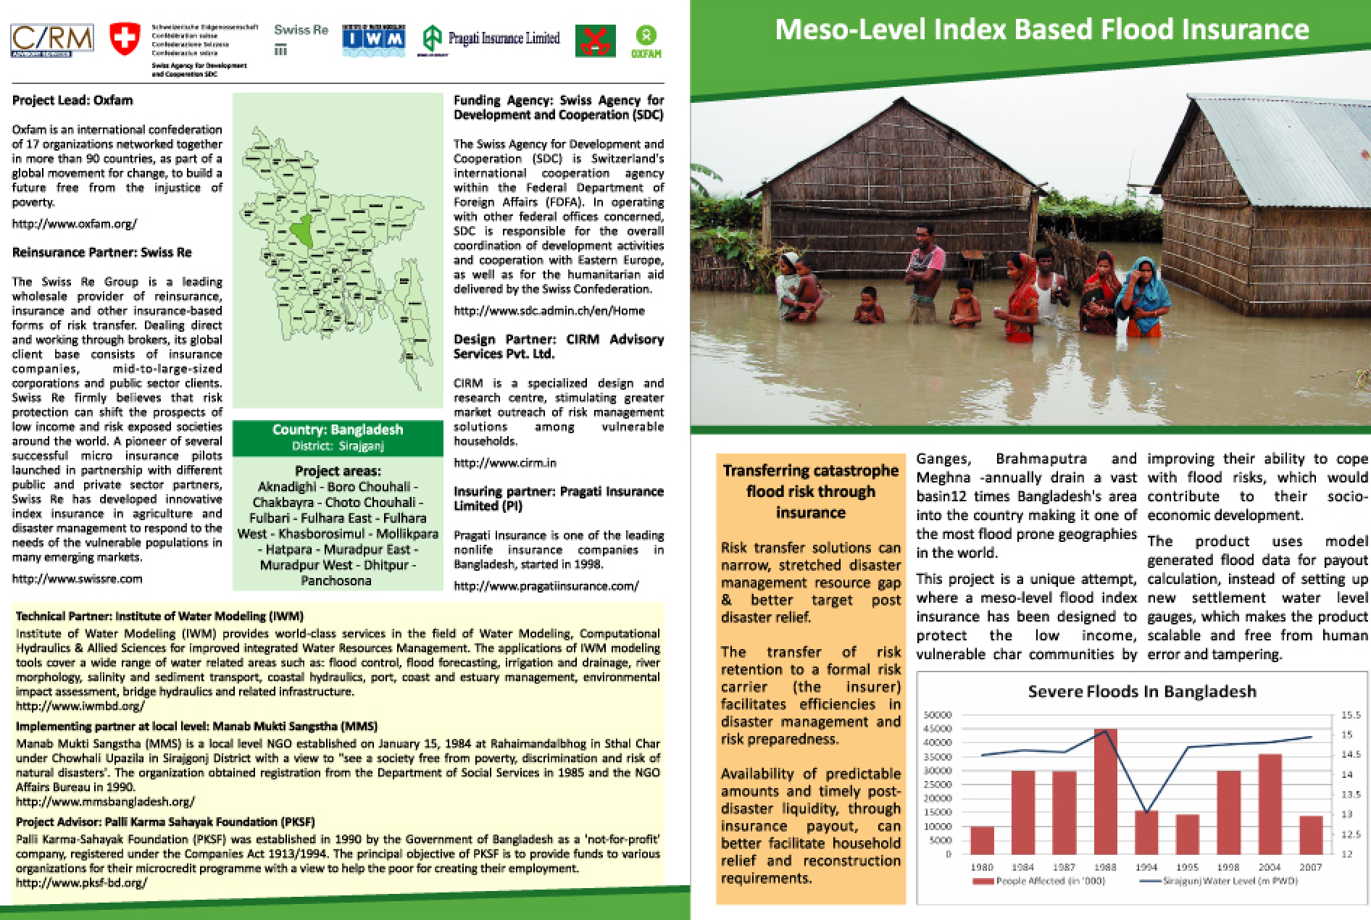
Rupalee Ruchismita, Fintech for Equity in Growth Mkts
How it started
Notes:
Robby - help me check the data they used to create the graph [link] by checking Global Findex Database.
micro-finance (non-profitable organization – create a group) – not providing credits – they do not have assets, your peer (every week – liquidity issues – critique: plain vanilla (only one product single credit product- need to pay weekly) – intertemporal payments – not a bank
wave after micro-financing: new generations tech enabled players reach the remote clients – access to finance model – creating own account, financial account manage credit/finance better
usurious

Slide 4
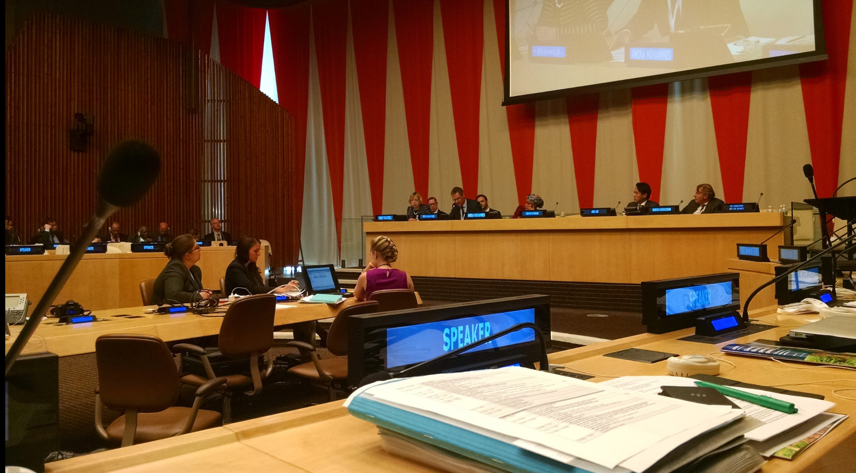
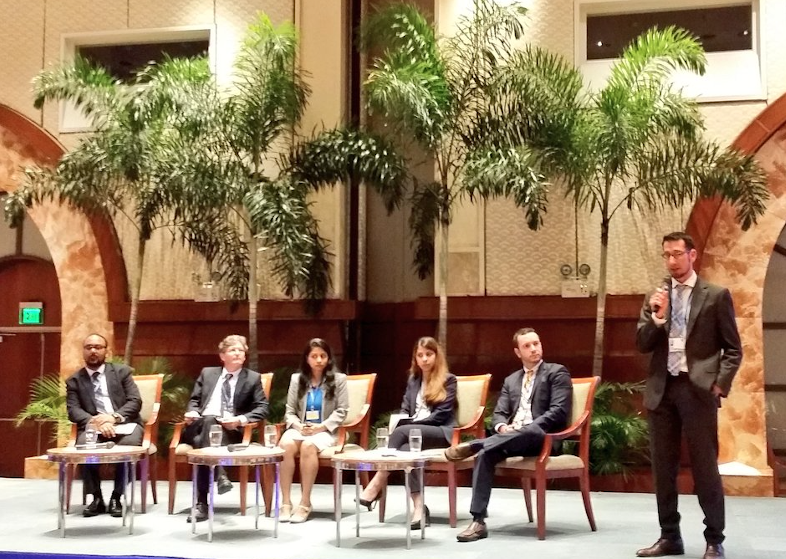
Rupalee Ruchismita, Fintech for Equity in Growth Mkts
How it’s going
Notes:
Robby - help me check the data they used to create the graph [link] by checking Global Findex Database.
micro-finance (non-profitable organization – create a group) – not providing credits – they do not have assets, your peer (every week – liquidity issues – critique: plain vanilla (only one product single credit product- need to pay weekly) – intertemporal payments – not a bank
wave after micro-financing: new generations tech enabled players reach the remote clients – access to finance model – creating own account, financial account manage credit/finance better
usurious

Slide 5
Designing for Fintech intermediaries
AI for curation and content creation
Low cost, interactive, personalized solution
Berkeley World Business Analytics ‘AI for Equity’ Award
Empowering Fintech merchants through high match value Productivity content

Slide 6
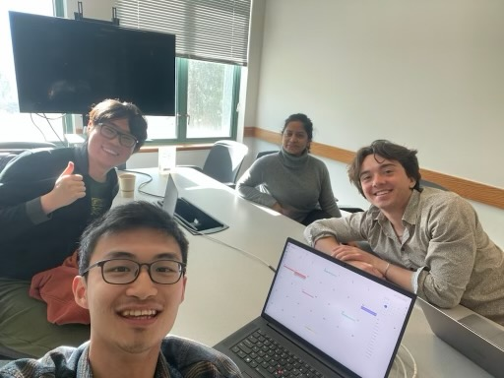
Rupalee Ruchismita, Fintech for Equity in Growth Mkts
How it started
Notes:
Robby - help me check the data they used to create the graph [link] by checking Global Findex Database.
micro-finance (non-profitable organization – create a group) – not providing credits – they do not have assets, your peer (every week – liquidity issues – critique: plain vanilla (only one product single credit product- need to pay weekly) – intertemporal payments – not a bank
wave after micro-financing: new generations tech enabled players reach the remote clients – access to finance model – creating own account, financial account manage credit/finance better
usurious

Slide 7
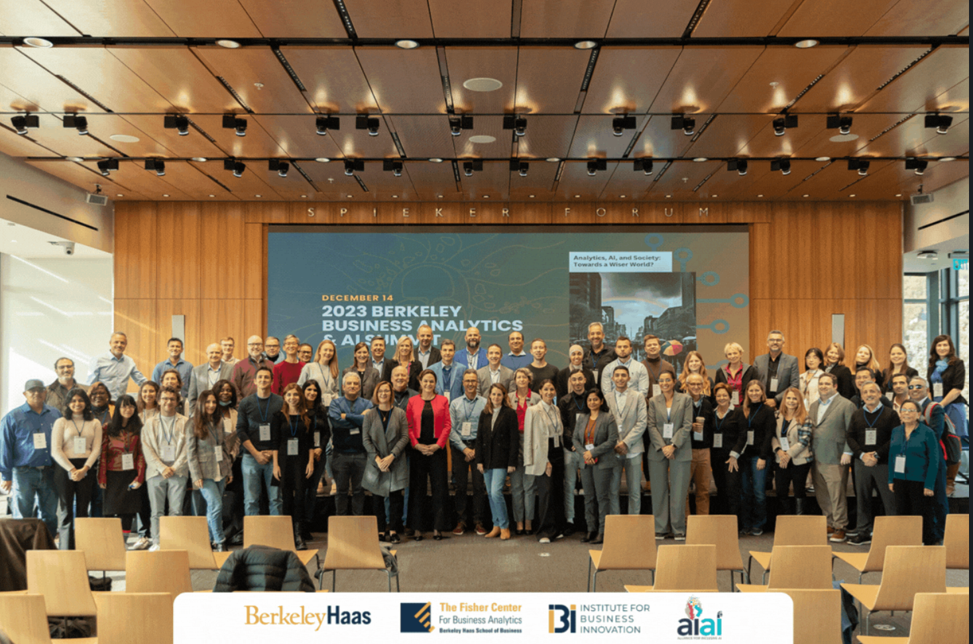
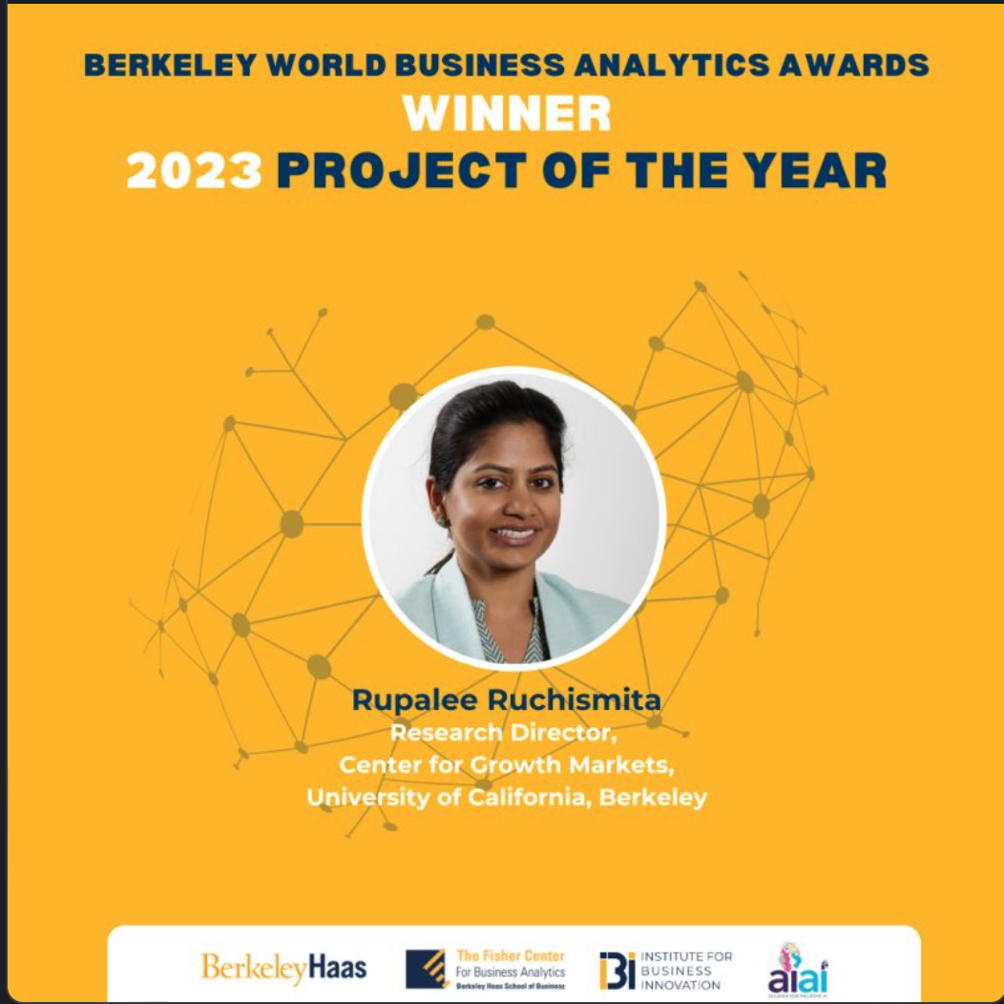
Rupalee Ruchismita, Fintech for Equity in Growth Mkts
How it’s going
Notes:
Robby - help me check the data they used to create the graph [link] by checking Global Findex Database.
micro-finance (non-profitable organization – create a group) – not providing credits – they do not have assets, your peer (every week – liquidity issues – critique: plain vanilla (only one product single credit product- need to pay weekly) – intertemporal payments – not a bank
wave after micro-financing: new generations tech enabled players reach the remote clients – access to finance model – creating own account, financial account manage credit/finance better
usurious

Slide 8
SBI- CGM, UC Berkeley Partnership
Feb, 2023

Slide 9
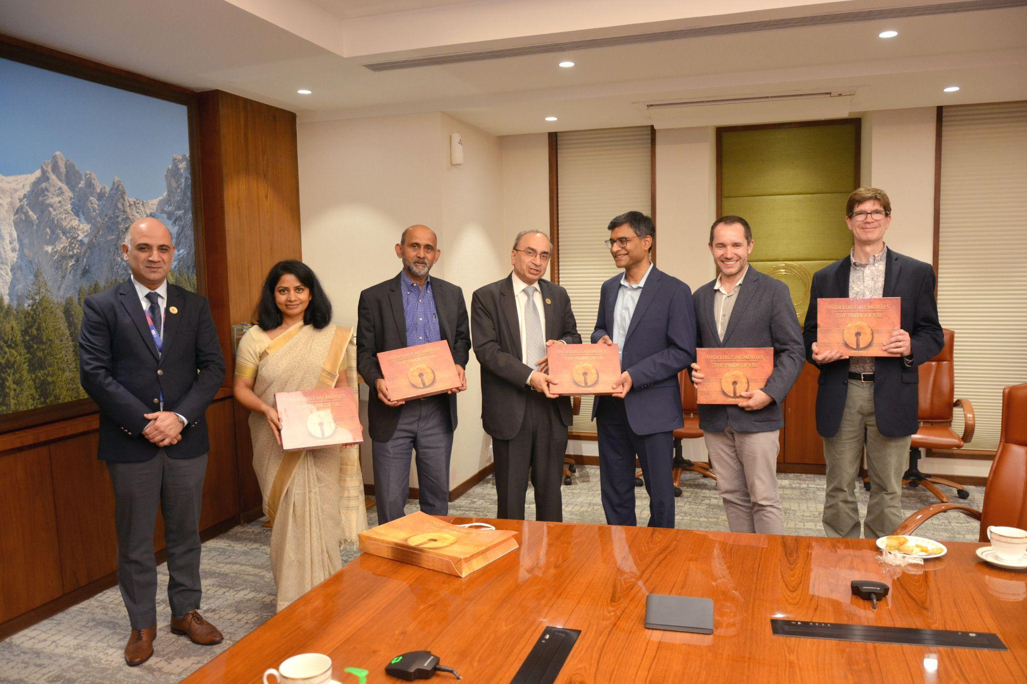
How it all Started
Notes:
Robby - help me check the data they used to create the graph [link] by checking Global Findex Database.
micro-finance (non-profitable organization – create a group) – not providing credits – they do not have assets, your peer (every week – liquidity issues – critique: plain vanilla (only one product single credit product- need to pay weekly) – intertemporal payments – not a bank
wave after micro-financing: new generations tech enabled players reach the remote clients – access to finance model – creating own account, financial account manage credit/finance better
usurious

Slide 10
Faculty Speaker

Slide 12
Tokenization
Christine A. Parlour

Slide 13
Frictions in Financial Transactions - I
Transfers payment
Payment moves separately from instrument
Settlement takes xx working days
Record keeping separate from messaging
Transfers instrument

Slide 14
Explicit Costs: Custody
Source: SEC

Slide 15
Frictions in Financial Transactions - II
Cash flows
Issuance
Securitize or payoff

Slide 16
Explicit Costs: Loan Servicing
Source: SEC

Slide 17
Also….Very complex

Slide 18
In all markets….

Slide 19
Economic Costs in current system
Clearing requires coordinated data
Settlement uncertainty
Collateral has to be posted e.g., nostro-vostro or CCPs
Opportunity cost of capital
Securities have to be moved between sub-custodians
Fails
Limited Time windows
Jump Risk when markets are closed

Slide 20
Models of Tokenization
Native tokens
Assets issued on-chain
Flexibility to design new types of assets (token is code)
Legal and regulatory issues
Non-native tokens
Financial institution holds RWA in custody
Issues tokens against them
Requires trust in the institution

Slide 21
Native Tokens
HSBC Orion
Regulated under Luxembourg digital asset/blockchain legislation
Central Account Keeper (CAK) like a CSD
Issues wallets and initiates transfers
Hyperledger but mirrored on Ethereum
Settlement token (specific payments not generalized)
Floating rate bond with the European Investment Bank (EIB)

Slide 22
Goldman Sachs Digital Asset Platform: GS DAP
EIB issued 100 million Euro 2 year digital bond on Goldman Sachs GS DAP Jan 2023
HK monetary authority issued 100 million green bond using GS protocol.
DvP using a Hashed Time Lock
Integrated into the Canton network which synchronizes across siloed blockchains

Slide 23
Economic Implications
Can reduce direct costs of issuing, custody and servicing.
If the blockchain permits different protocols (trade, lending) increase secondary market liquidity and use value of the asset.
Interoperability is very important, else blockchain operator has market power.
Form of interoperability is important else credit risk.
In DeFi Bridges are often hacked.

Slide 24
Real World Assets (RWA) on chain
Tokenization to increase secondary market liquidity
Tokenization to allow fractionalization.
Tokenization makes it easier to switch and use collateral
Align Technological transfer with title transfer (no fails)

Slide 25
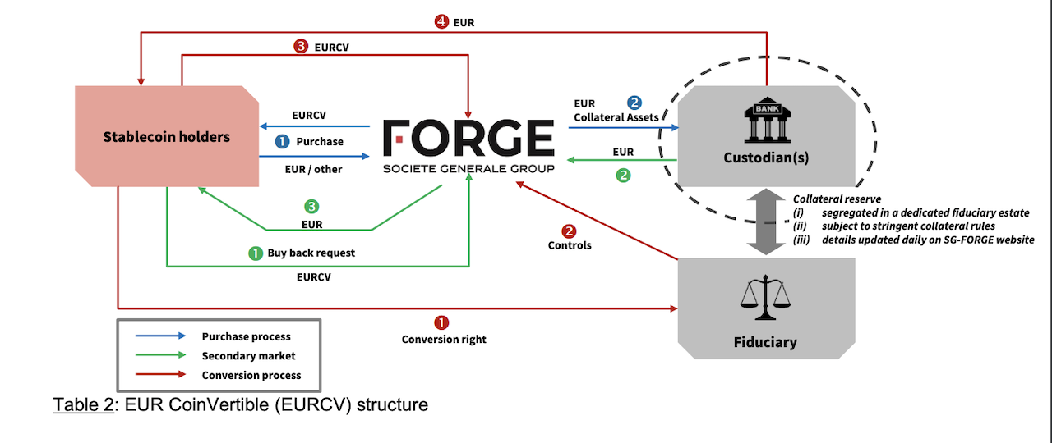
Soc Gen “Forge” Coinvertible
A Euro demonimated digital asset under French Law
Economically like a MMF
Issued on the Ethereum blockchain – only available to whitelisted addresses.

Slide 26
Tokenized Treasury funds

Slide 27
Issuers

Slide 28
Differences between funds
Choice of Reserve Assets (collateral)
Redemptions protocols
How to ensure AML/KYC
Choice of Blockchains

Slide 29
Regulated Liabilities (different collateral)
Regulated financial industries are designing other products that can be used for payments.
Citi has proposed a “Regulated Liability Network’’
National currencies or “regulated liabilities”
Interoperable
Prevents dollarization

Slide 30
Citi Token
Citi Token:
Deposits are tokenized and can be used for cross-border payments 24/7
“Regulated Liabilities”
Prevents dollarization
Cash Management and Trade finance.
HQLA (by Goldman Sachs):
DLT R3 Corda
Collateral management for Institutional Clients
Delivery versus Delivery (no cash)

Slide 31
Broadridge Distributed Ledger Repo
Existing connections to securities depositories and custodians
Tokenize collateral
Payment through conventional rails but occurs at the same time as settlement ``atomic’’
Source: Broadridge.com

Slide 32
DLT Repo
Smart contracts provide flexibility on terms etc.
Direct cost savings on reconciliation
Reduce risk (fails, credit etc.)
Increased collateral mobility
Easy for Broadridge to convert custody relationships to tokenize collateral and deploy smart contracts on a DL

Slide 33
Finance/Economic Repo Implications
Successful: 50 bn daily or 1 trillion a month
Intraday Repo are easy to implement
Many are intra-company repos
Does this have an aggregate effect on collateral usage/demand?
Does this make banks more/less resilient?

Slide 34
Hamilton Lane tokenizes investment products
On Polygon
Partnership with Securitize (which will manage these)
Issue tokens against illiquid alternate assets such as RE, art etc.
Reduce costs and make it easier to offer smaller smaller investment sizes.
Tap deeper capital markets

Slide 35
Project Guardian (Monetary Authority Singapore)
Wide ranging project to experiment with tokenization
Determine best practices on
Interoperability
Standardization
Legal framework

Slide 36
Finance/Economic Implications RWA
For Investor:
Buy alternate asset classes with a smaller minimum investment
Assets more liquid and easier to use as collateral.
For firms/issuers
Decrease cost of capital (reduction in direct costs)
Increase investor base
Reduces monitoring incentives potentially increase cost of capital

Slide 37
Questions around Systemic Risk
Are slow financial systems better?
Are automated systems less secure?
How should regulators interact with enterprise blockchain?
Are tokenized assets more fragile?
What changes should be made in securities law/regulation?

Slide 38
New Economic Questions
What exactly are the economic tradeoffs in these new systems?
Are they economically efficient?
Will they lead to more or less market concentration?

Slide 39
Day 1: Where are we
Where we are going

Slide 42
Industry Speaker

Slide 43
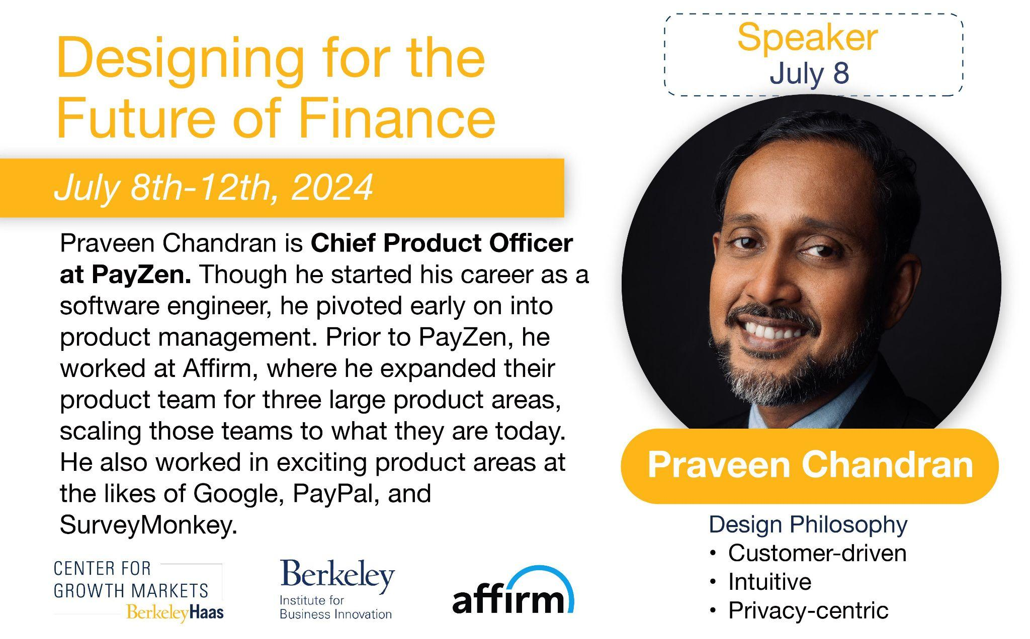

Slide 44
Speaker Profile
Praveen
Focused on core checkout and onboarding at PayPal, and repayments at Affirm
Transformed PayPal’s onboarding experience in 192 countries.
Reduced repayment losses by 12%+ at Affirm
Hobbies: Watching cartoon with my daughter!!!
My Design Philosophy
Customer-centric (“what the customer wants”)
Intuitive (“don’t make the customer learn or guess”)
Privacy-centric (“build trust with the customer”)
Notes:
Robby - help me check the data they used to create the graph [link] by checking Global Findex Database.
micro-finance (non-profitable organization – create a group) – not providing credits – they do not have assets, your peer (every week – liquidity issues – critique: plain vanilla (only one product single credit product- need to pay weekly) – intertemporal payments – not a bank
wave after micro-financing: new generations tech enabled players reach the remote clients – access to finance model – creating own account, financial account manage credit/finance better
usurious

Slide 45
Context: Fintech Firms
Firm culture
PayPal is a checkout solutions provider in a two-sided market. PayPal followed customer driven design thinking powered by quantitative data.
Affirm is a BNPL provider in a two-sided market. Affirm’s product requirements starts with the business case and the design decisions are based on customer empathy.
SurveyMonkey is an enterprise survey software provider. The design decisions were largely focused on customer personas and the needs of each persona.
Notes:
Robby - help me check the data they used to create the graph [link] by checking Global Findex Database.
micro-finance (non-profitable organization – create a group) – not providing credits – they do not have assets, your peer (every week – liquidity issues – critique: plain vanilla (only one product single credit product- need to pay weekly) – intertemporal payments – not a bank
wave after micro-financing: new generations tech enabled players reach the remote clients – access to finance model – creating own account, financial account manage credit/finance better
usurious

Slide 46
Right Design Tools aligned to the Firm Culture
How tools/ focus on specific stages differ based on firm priorities
PayPal: Design team is embedded within the product team. Two types of launches
Major product launches adopted rigorous user research
Experimentation driven launch for features
Affirm: Operated in two models at different times - embedded design team and centralized design team
Repayments was heavily dependent on experimentation driven features
User research conducted on critical questions and for new product ideas
Google: Centralized design team
Customer Advisory Board (CAB)
SurveyMonkey: Centralized design team
User research for major enterprise launches
Notes:
Robby - help me check the data they used to create the graph [link] by checking Global Findex Database.
micro-finance (non-profitable organization – create a group) – not providing credits – they do not have assets, your peer (every week – liquidity issues – critique: plain vanilla (only one product single credit product- need to pay weekly) – intertemporal payments – not a bank
wave after micro-financing: new generations tech enabled players reach the remote clients – access to finance model – creating own account, financial account manage credit/finance better
usurious

Slide 47
Deep Dive with Disruptors
Designing for the Future of Finance
Praveen Chandran: QnA with Rupa Ruchismita
July 8th, 2024
@Chou Hall
Praveen,
Chief Product Officer,
PayZen

Slide 48
Speaker Profile
Praveen
Focused on core checkout and onboarding at PayPal, and repayments at Affirm
Transformed PayPal’s onboarding experience in 192 countries.
Reduced repayment losses by 12%+ at Affirm
Hobbies: Watching cartoon with my daughter!!!
My Design Philosophy
Customer-centric (“what the customer wants”)
Intuitive (“don’t make the customer learn or guess”)
Privacy-centric (“build trust with the customer”)
Notes:
Robby - help me check the data they used to create the graph [link] by checking Global Findex Database.
micro-finance (non-profitable organization – create a group) – not providing credits – they do not have assets, your peer (every week – liquidity issues – critique: plain vanilla (only one product single credit product- need to pay weekly) – intertemporal payments – not a bank
wave after micro-financing: new generations tech enabled players reach the remote clients – access to finance model – creating own account, financial account manage credit/finance better
usurious

Slide 49
Context: Fintech Firms
Firm culture
PayPal is a checkout solutions provider in a two-sided market. PayPal followed customer driven design thinking powered by quantitative data.
Affirm is a BNPL provider in a two-sided market. Affirm’s product requirements starts with the business case and the design decisions are based on customer empathy.
SurveyMonkey is an enterprise survey software provider. The design decisions were largely focused on customer personas and the needs of each persona.
Notes:
Robby - help me check the data they used to create the graph [link] by checking Global Findex Database.
micro-finance (non-profitable organization – create a group) – not providing credits – they do not have assets, your peer (every week – liquidity issues – critique: plain vanilla (only one product single credit product- need to pay weekly) – intertemporal payments – not a bank
wave after micro-financing: new generations tech enabled players reach the remote clients – access to finance model – creating own account, financial account manage credit/finance better
usurious

Slide 50
Right Design Tools aligned to the Firm Culture
How tools/ focus on specific stages differ based on firm priorities
PayPal: Design team is embedded within the product team. Two types of launches
Major product launches adopted rigorous user research
Experimentation driven launch for features
Affirm: Operated in two models at different times - embedded design team and centralized design team
Repayments was heavily dependent on experimentation driven features
User research conducted on critical questions and for new product ideas
Google: Centralized design team
Customer Advisory Board (CAB)
SurveyMonkey: Centralized design team
User research for major enterprise launches
Notes:
Robby - help me check the data they used to create the graph [link] by checking Global Findex Database.
micro-finance (non-profitable organization – create a group) – not providing credits – they do not have assets, your peer (every week – liquidity issues – critique: plain vanilla (only one product single credit product- need to pay weekly) – intertemporal payments – not a bank
wave after micro-financing: new generations tech enabled players reach the remote clients – access to finance model – creating own account, financial account manage credit/finance better
usurious

Slide 51
Design in Regulated Domains: My toolkit!
My Product Leadership tools
My secret sauce to making the design cycle land successfully is to inculcate a clear process for design thinking focused on customer needs and de-risking launches
Have we clearly validated the customer requirements?
Have we validated the market size for the requirements?
Tools/stages are critical for me given the context I operate in
Internal:
Opportunity sizing, solution sizing
Product Requirements Document (PRD), Design reviews, Engineering handoffs
External:
Market validation through user research and/or experimentation
Notes:
Robby - help me check the data they used to create the graph [link] by checking Global Findex Database.
micro-finance (non-profitable organization – create a group) – not providing credits – they do not have assets, your peer (every week – liquidity issues – critique: plain vanilla (only one product single credit product- need to pay weekly) – intertemporal payments – not a bank
wave after micro-financing: new generations tech enabled players reach the remote clients – access to finance model – creating own account, financial account manage credit/finance better
usurious

Slide 52
Summary
Process Recommendations for SBI
Document customer needs
Validate using user research
Customer advisory board / focus groups
Domain Recommendations for SBI
Privacy centricity is important
Intuitive flows are critical to building a strong customer base
API centricity helps with faster adoption

Slide 53
Day One Wrap

